Slide 1


MODULE 3: PROGRAMMING FOR BIOLOGICAL DATA
Session 4: Visualizing Clinical Data
Building Dashboards and QC Charts with ggplot2
Instructor: Dr. Gu Haogao
January 14, 2026

Slide 2


The "Black Box" Problem
The Table
The Plot
10,000 rows of numbers.
Visual patterns.
Computers love it.
Humans love it.
Humans cannot spot errors.
"The outlier screams at you."

Slide 3

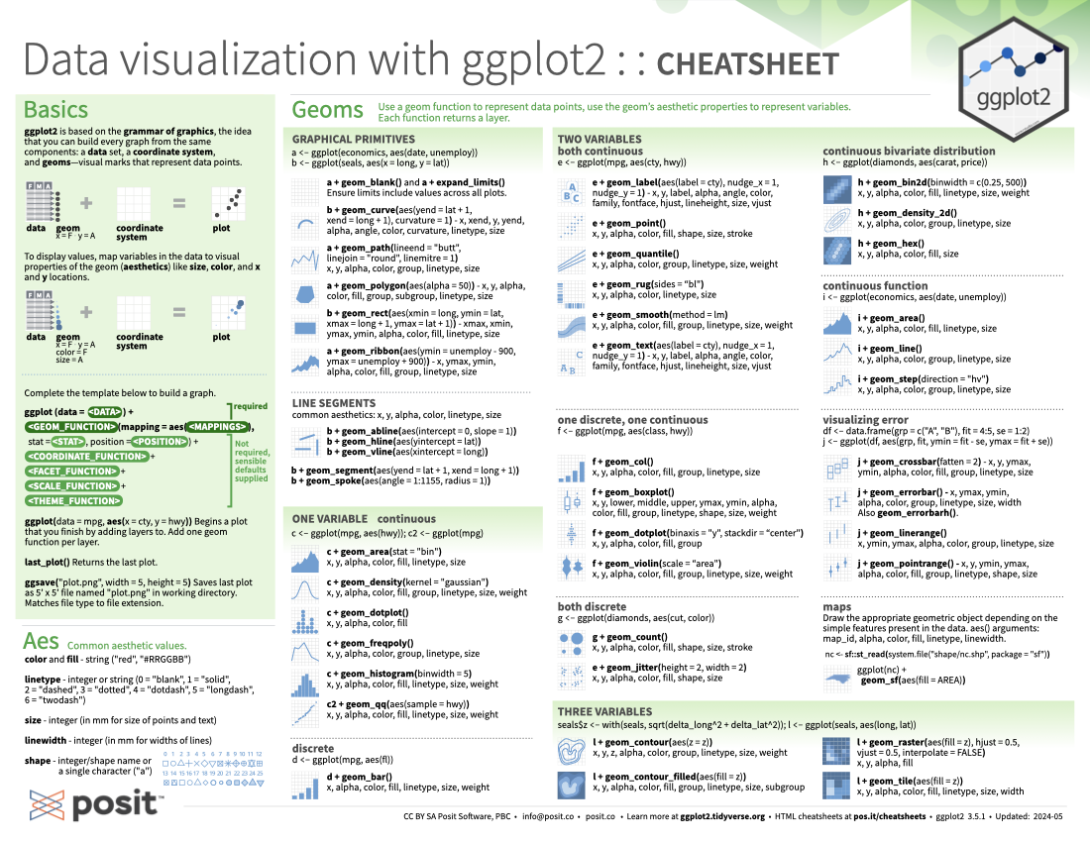
Introducing ggplot2
The "Grammar of Graphics"
We build a plot layer by layer, just like Photoshop or a sandwich.
Reproducible: Code-based (not point-and-click).
Scalable: Handles millions of points.
Standardized: Consistent look for every report.

Slide 4
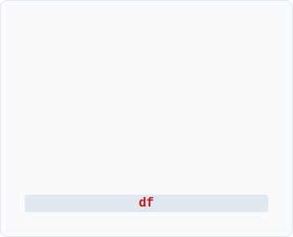
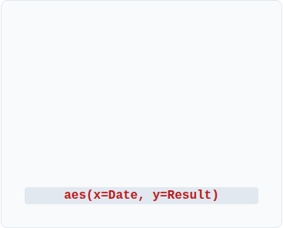
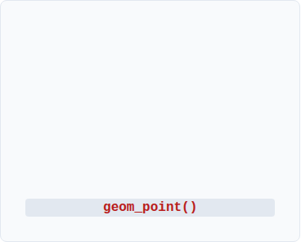



The 3 Pillars of a Plot
1. Data
2. Aesthetics
3. Geometry
The raw dataframe
Mapping data to visuals
The shape of the data

Slide 5
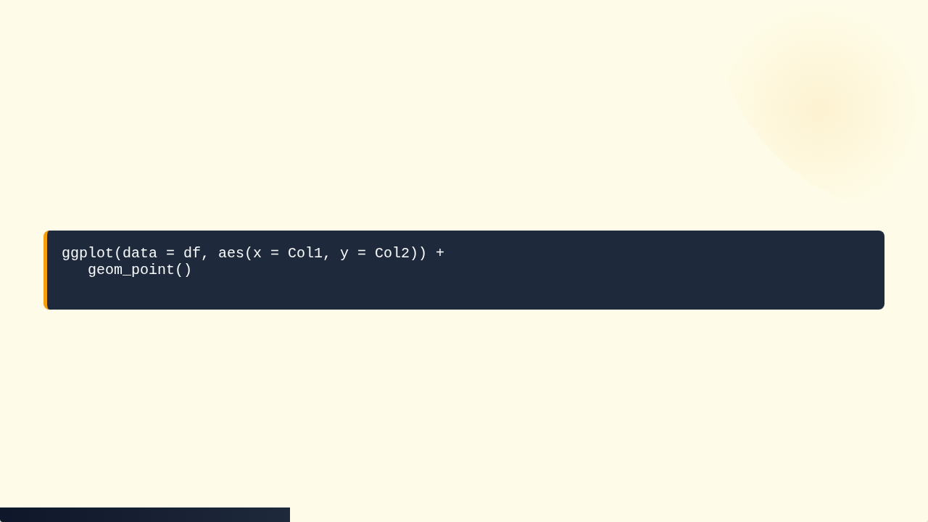
The Syntax Template
The Golden Rule: The + sign connects the layers. It MUST go at the end of the line!

Slide 6
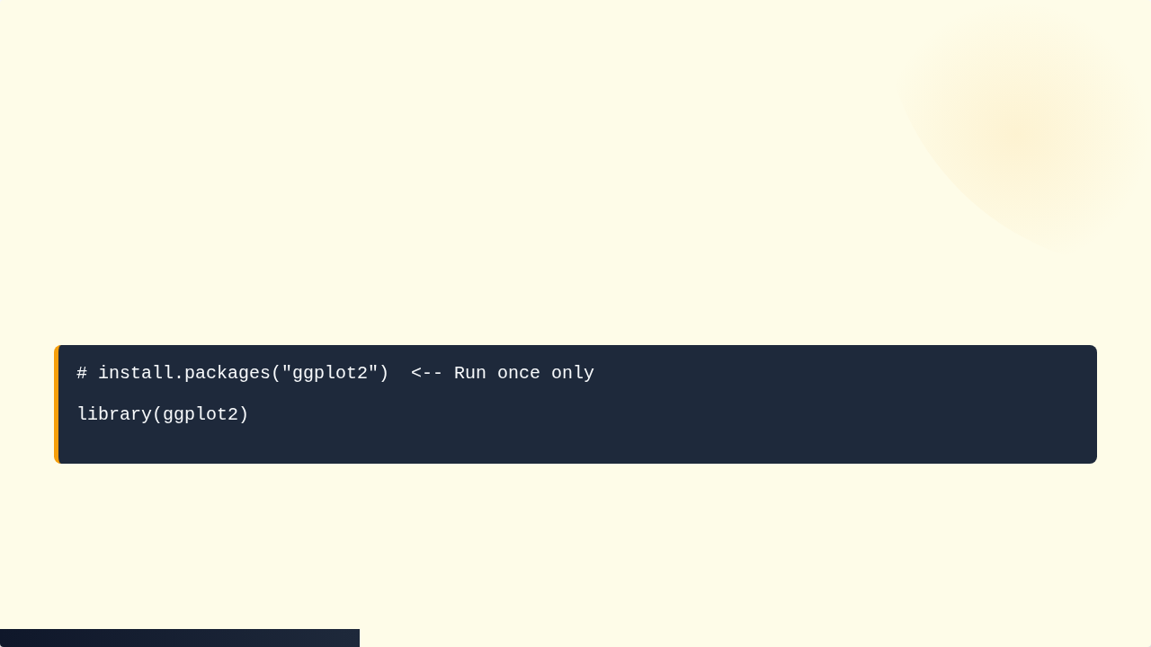
Step 0: Load the Library
ggplot2 is not in "Base R". We must load it from the shelf.

Slide 7
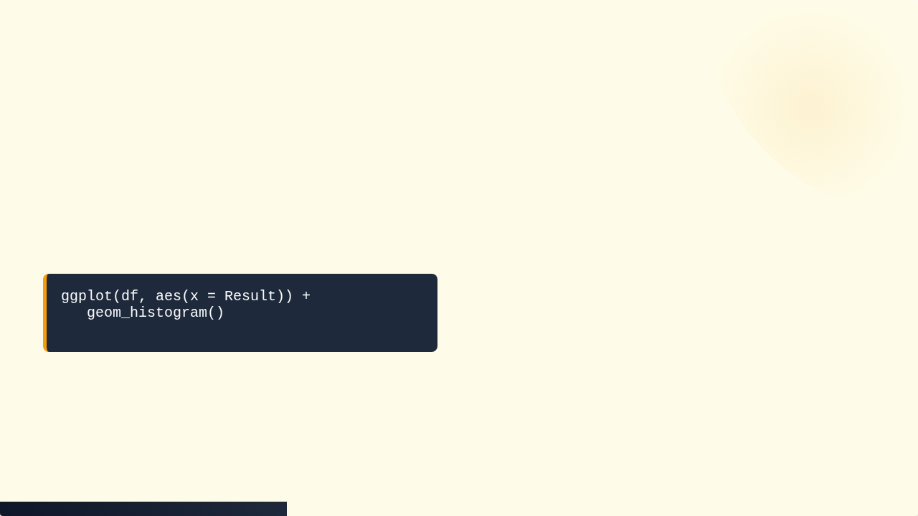
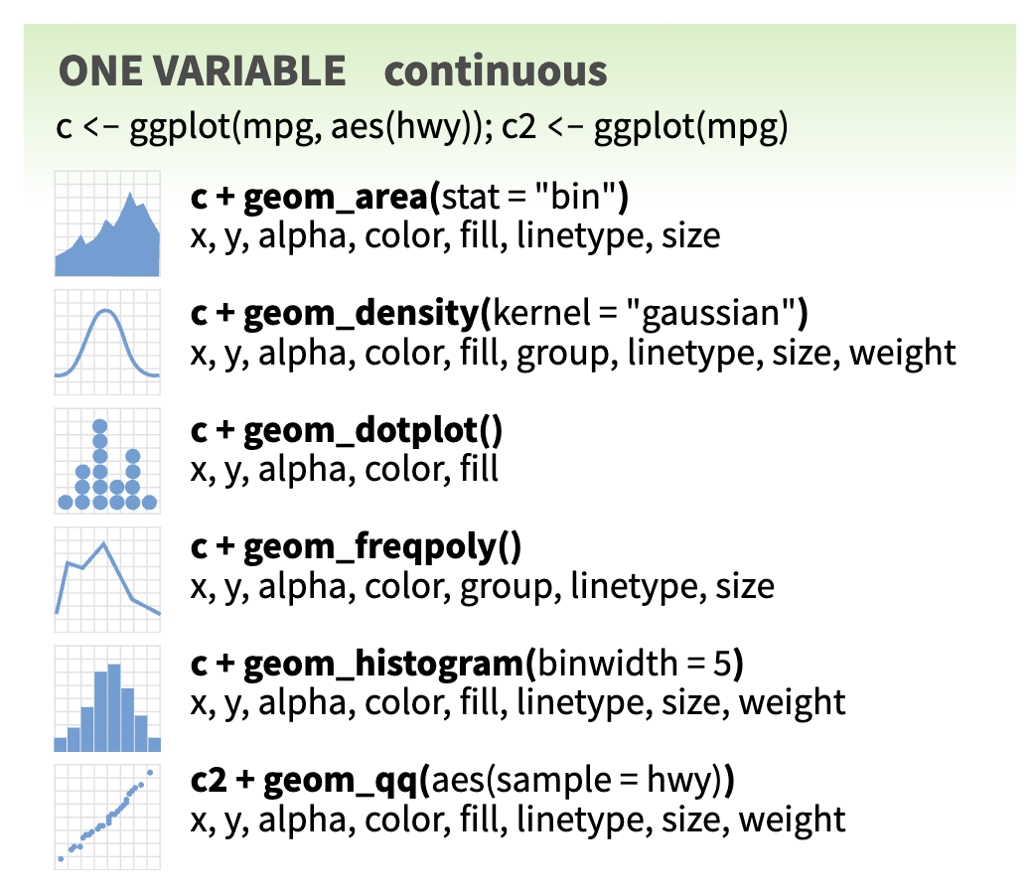

Geom 1: The Histogram (Distribution)
Goal: Check if patient data follows a Normal Distribution.
Is it skewed? Are there two peaks (batch effect)?

Slide 8
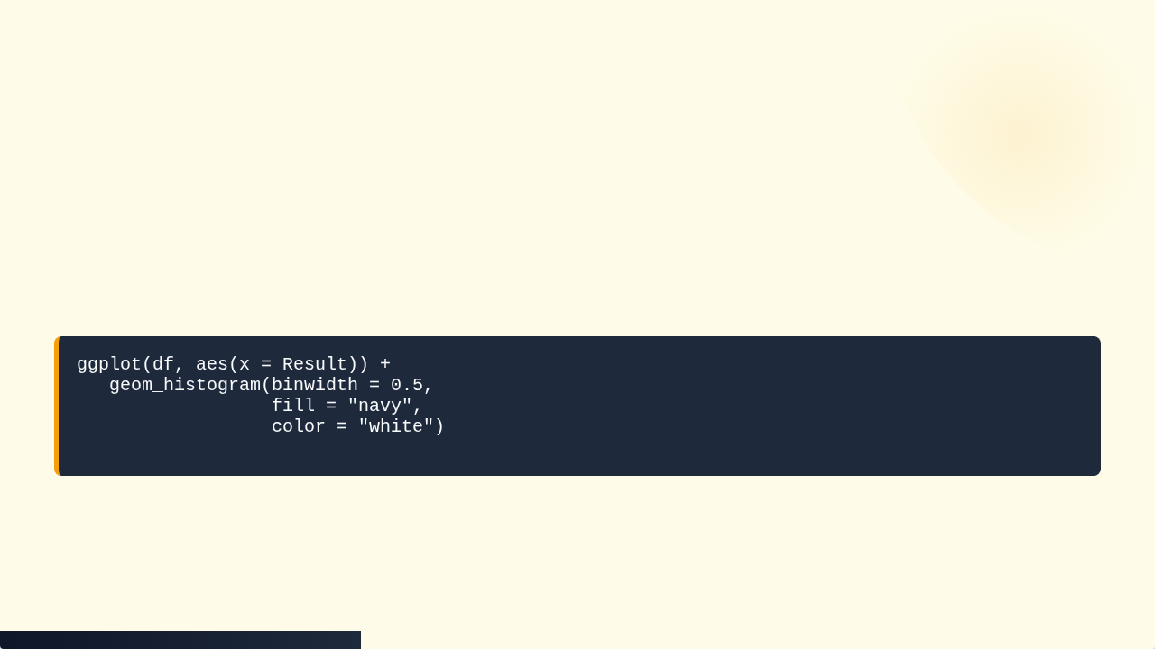
Customizing the Histogram
Make it look scientific by adding color and binwidth.

Slide 9
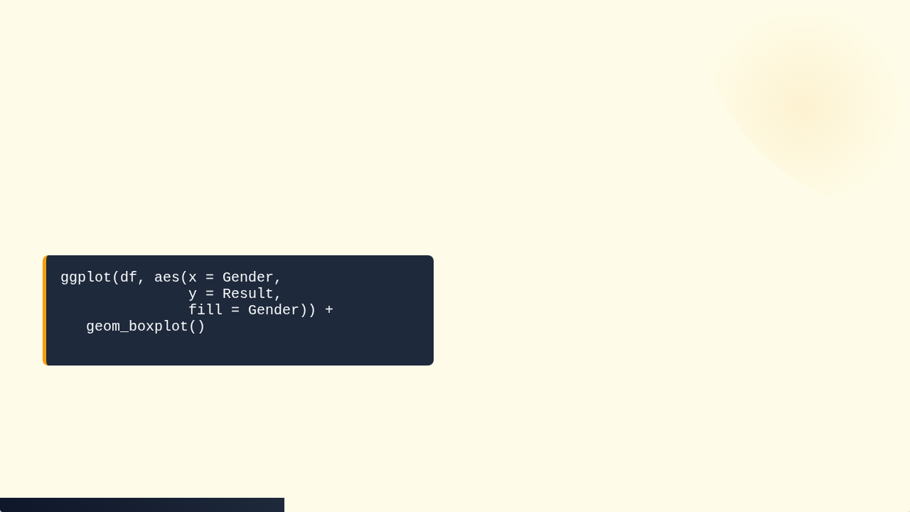
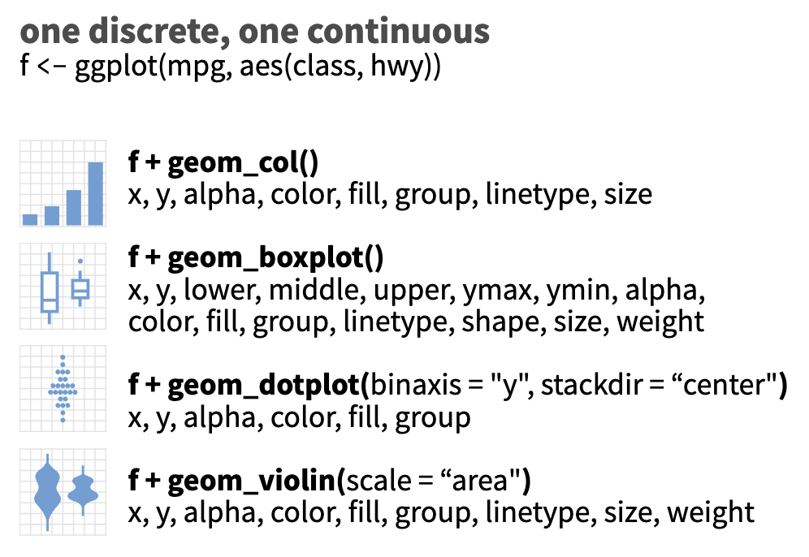
Geom 2: The Boxplot (Comparisons)
Goal: Compare results between groups (Male vs Female, Machine A vs B).
Shows Median, IQR, and Outliers.

Slide 10
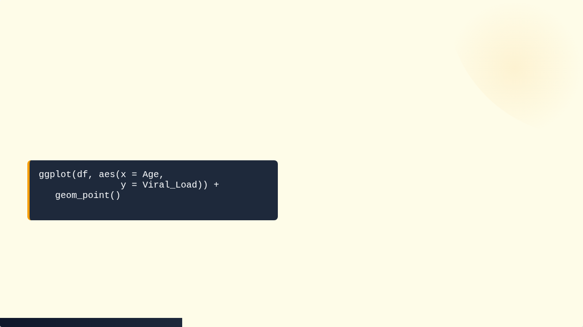
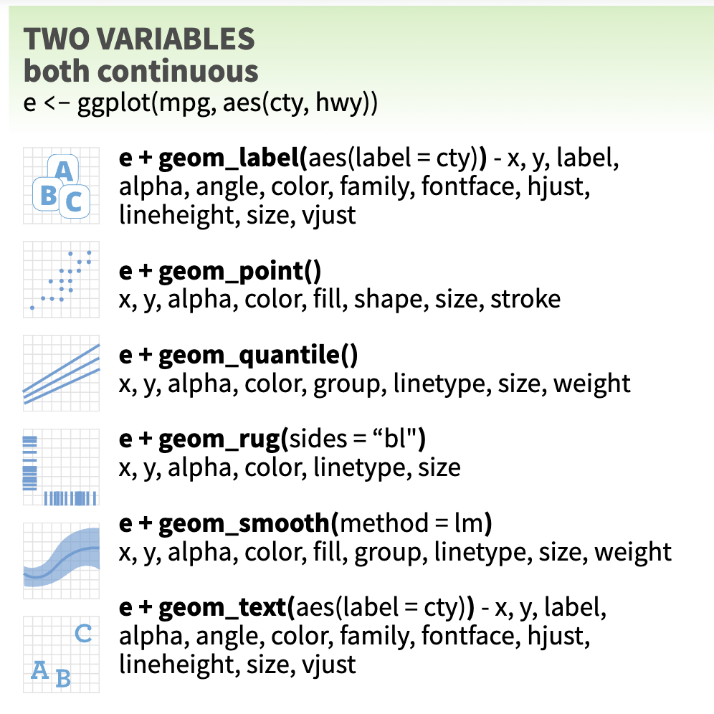
Geom 3: The Scatter Plot (Correlation)
Goal: Comparing two continuous variables.
Are older patients getting sicker?

Slide 11
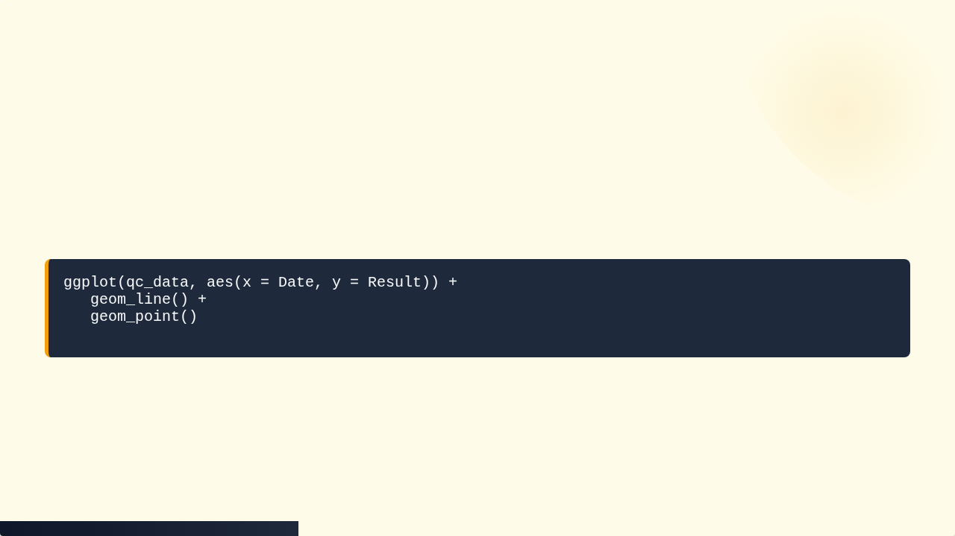
Geom 4: The Line Plot (Time Series)
Goal: The QC Levey-Jennings Chart.
Tracking values over time to spot trends or drifts.

Slide 12
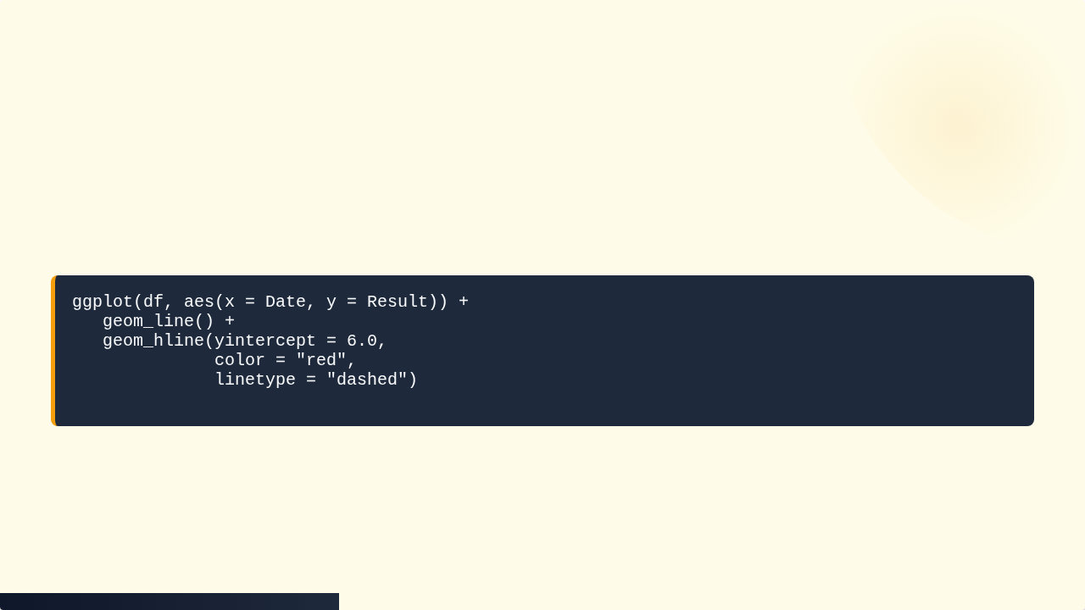
Layering: Adding Thresholds
A chart needs context. We draw the "Limit Line".
Any point above the red line is instantly recognizable as critical.

Slide 13
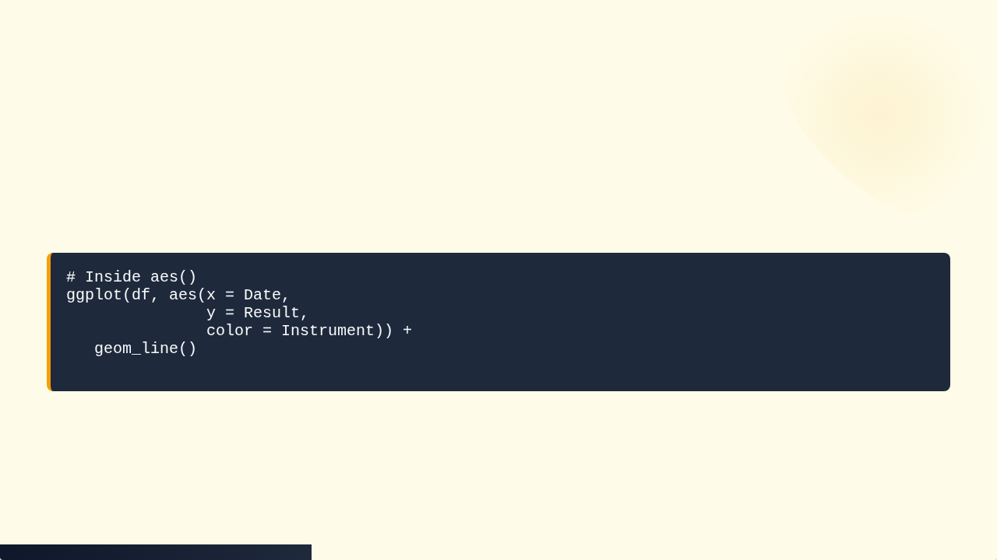
Mapping Color to Data
Don't just color it blue. Color it by meaning.
R automatically creates a legend and assigns colors to each Instrument.

Slide 14
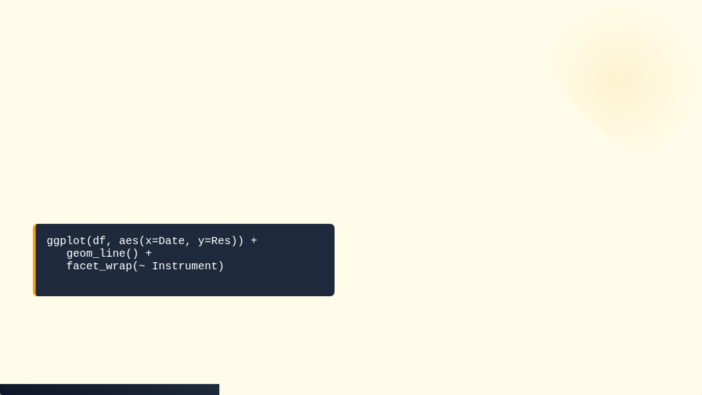
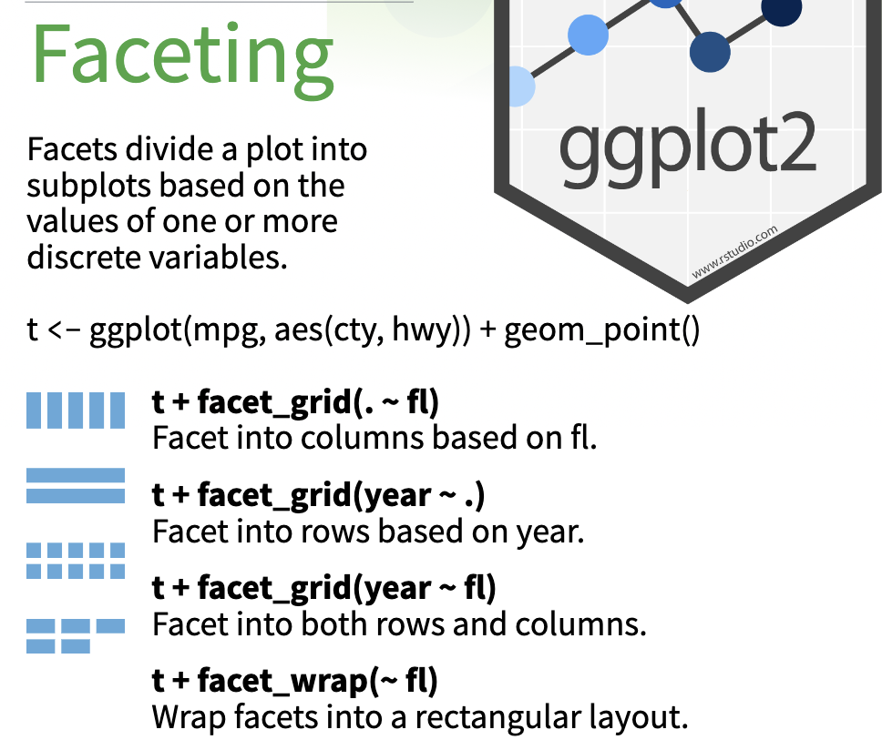
Faceting (Small Multiples)
Problem: 10 instruments on one chart is messy.
Solution: Faceting.

Slide 15
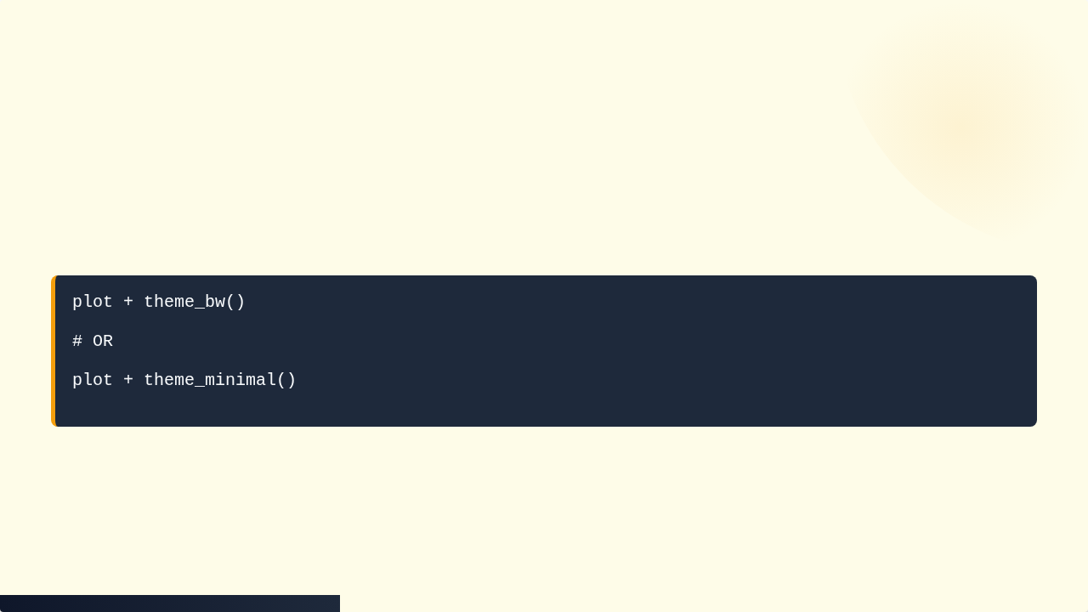
Themes (Publication Ready)
Remove the default grey background for a professional look.
theme_bw() is best for clinical reports (saves printer ink).

Slide 16

Saving Plots
Don't take screenshots. Export high-res images programmatically.

Slide 17



Practice: The Levey-Jennings Plan
1. Base
2. Context
3. Limits
Plot Points & Lines
Add Mean Line
Add +/- 2SD Lines

Slide 18
Summary of Geometries
geom_point(): Scatter Plot
geom_line(): Time Series
geom_bar(): Counts
geom_boxplot(): Stats Comparison
geom_histogram(): Distribution

Slide 19
Summary of Aesthetics
x, y: Position coordinates
color: Line/Point color (outline)
fill: Bar/Box color (inside)
size: Size of points
alpha: Transparency (0=invisible, 1=solid)

Slide 20

Tutorial 4: The QC Trend Analysis
Goal: Build a Monthly Levey-Jennings Chart to compare two instruments.
1. Load Data
2. Visualize Trend
3. Add QC Limits

Slide 21
Step 1: Load Data
library(ggplot2) url <- "https://raw.githubusercontent.com/.../daily_qc_trend.csv" qc_data <- read.csv(url) # Check head(qc_data)

Slide 22
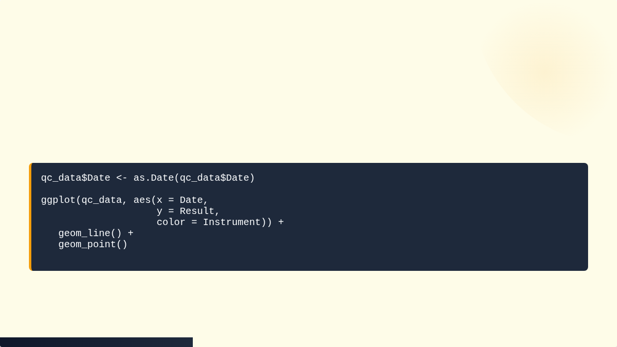
Step 2: Basic Time Series
Ensure Date is recognized, then plot.

Slide 23
Step 3: Interpreting the Mess
The lines overlap. It is hard to see which machine is drifting.
Solution: Faceting.

Slide 24
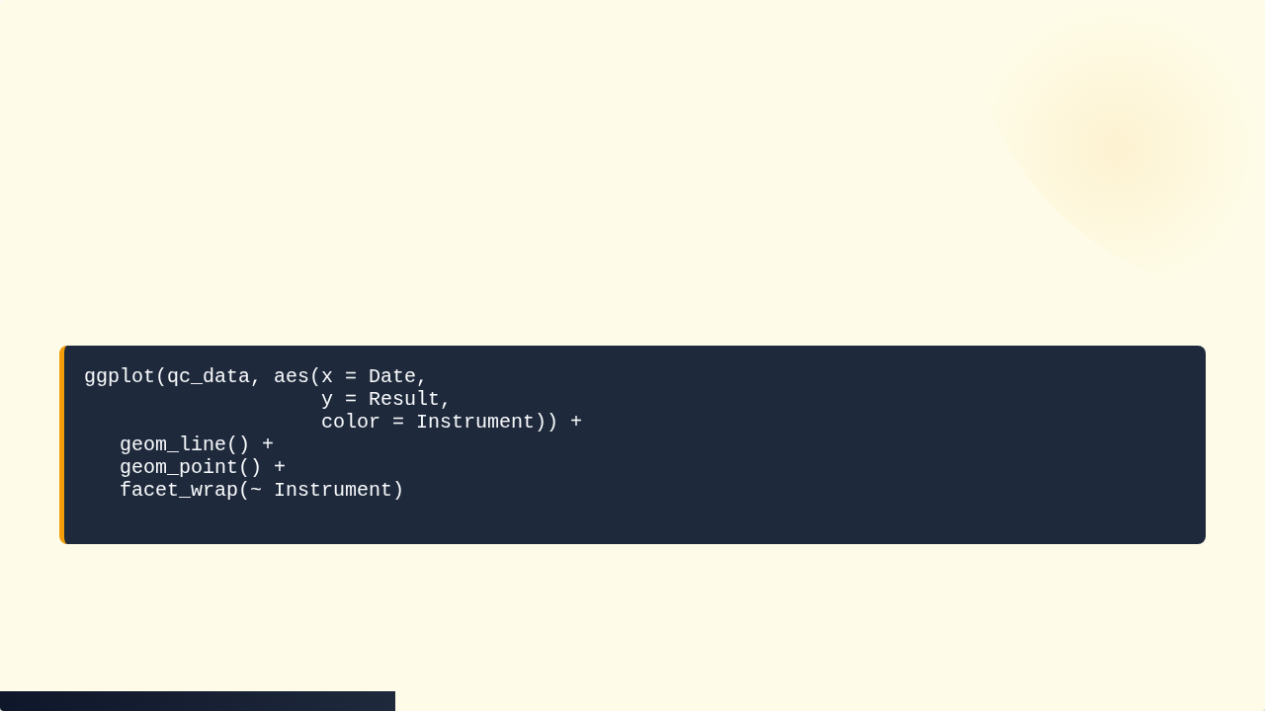
Step 4: Faceting
Split into two panels for clarity.

Slide 25
Step 5: Adding QC Limits
Known Values: Mean = 5.0, SD = 0.2
Mean: 5.0 (Black Line)
+2SD: 5.4 (Red Dashed)
-2SD: 4.6 (Red Dashed)

Slide 26
Step 6: Code for Limits
... + geom_hline(yintercept = 5.0, color = "black") + geom_hline(yintercept = 5.4, color = "red", linetype = "dashed") + geom_hline(yintercept = 4.6, color = "red", linetype = "dashed")

Slide 27
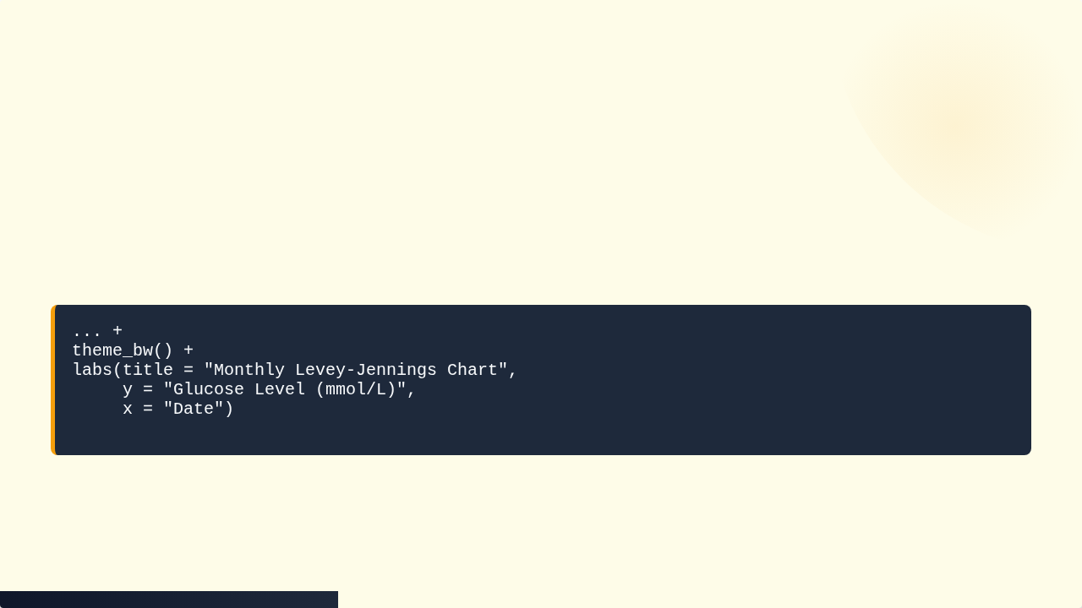
Step 7: Final Polish
Add title and clean theme.

Slide 28
Analysis: The Diagnosis
Machine B
Machine A
Flat line.
Bouncing around.
Very precise.
Point on Jan 14 is 5.8 (> 3SD).
PASS
FAIL (Outlier)

Slide 29

Step 8: Export
Save your clinical report.

Slide 30
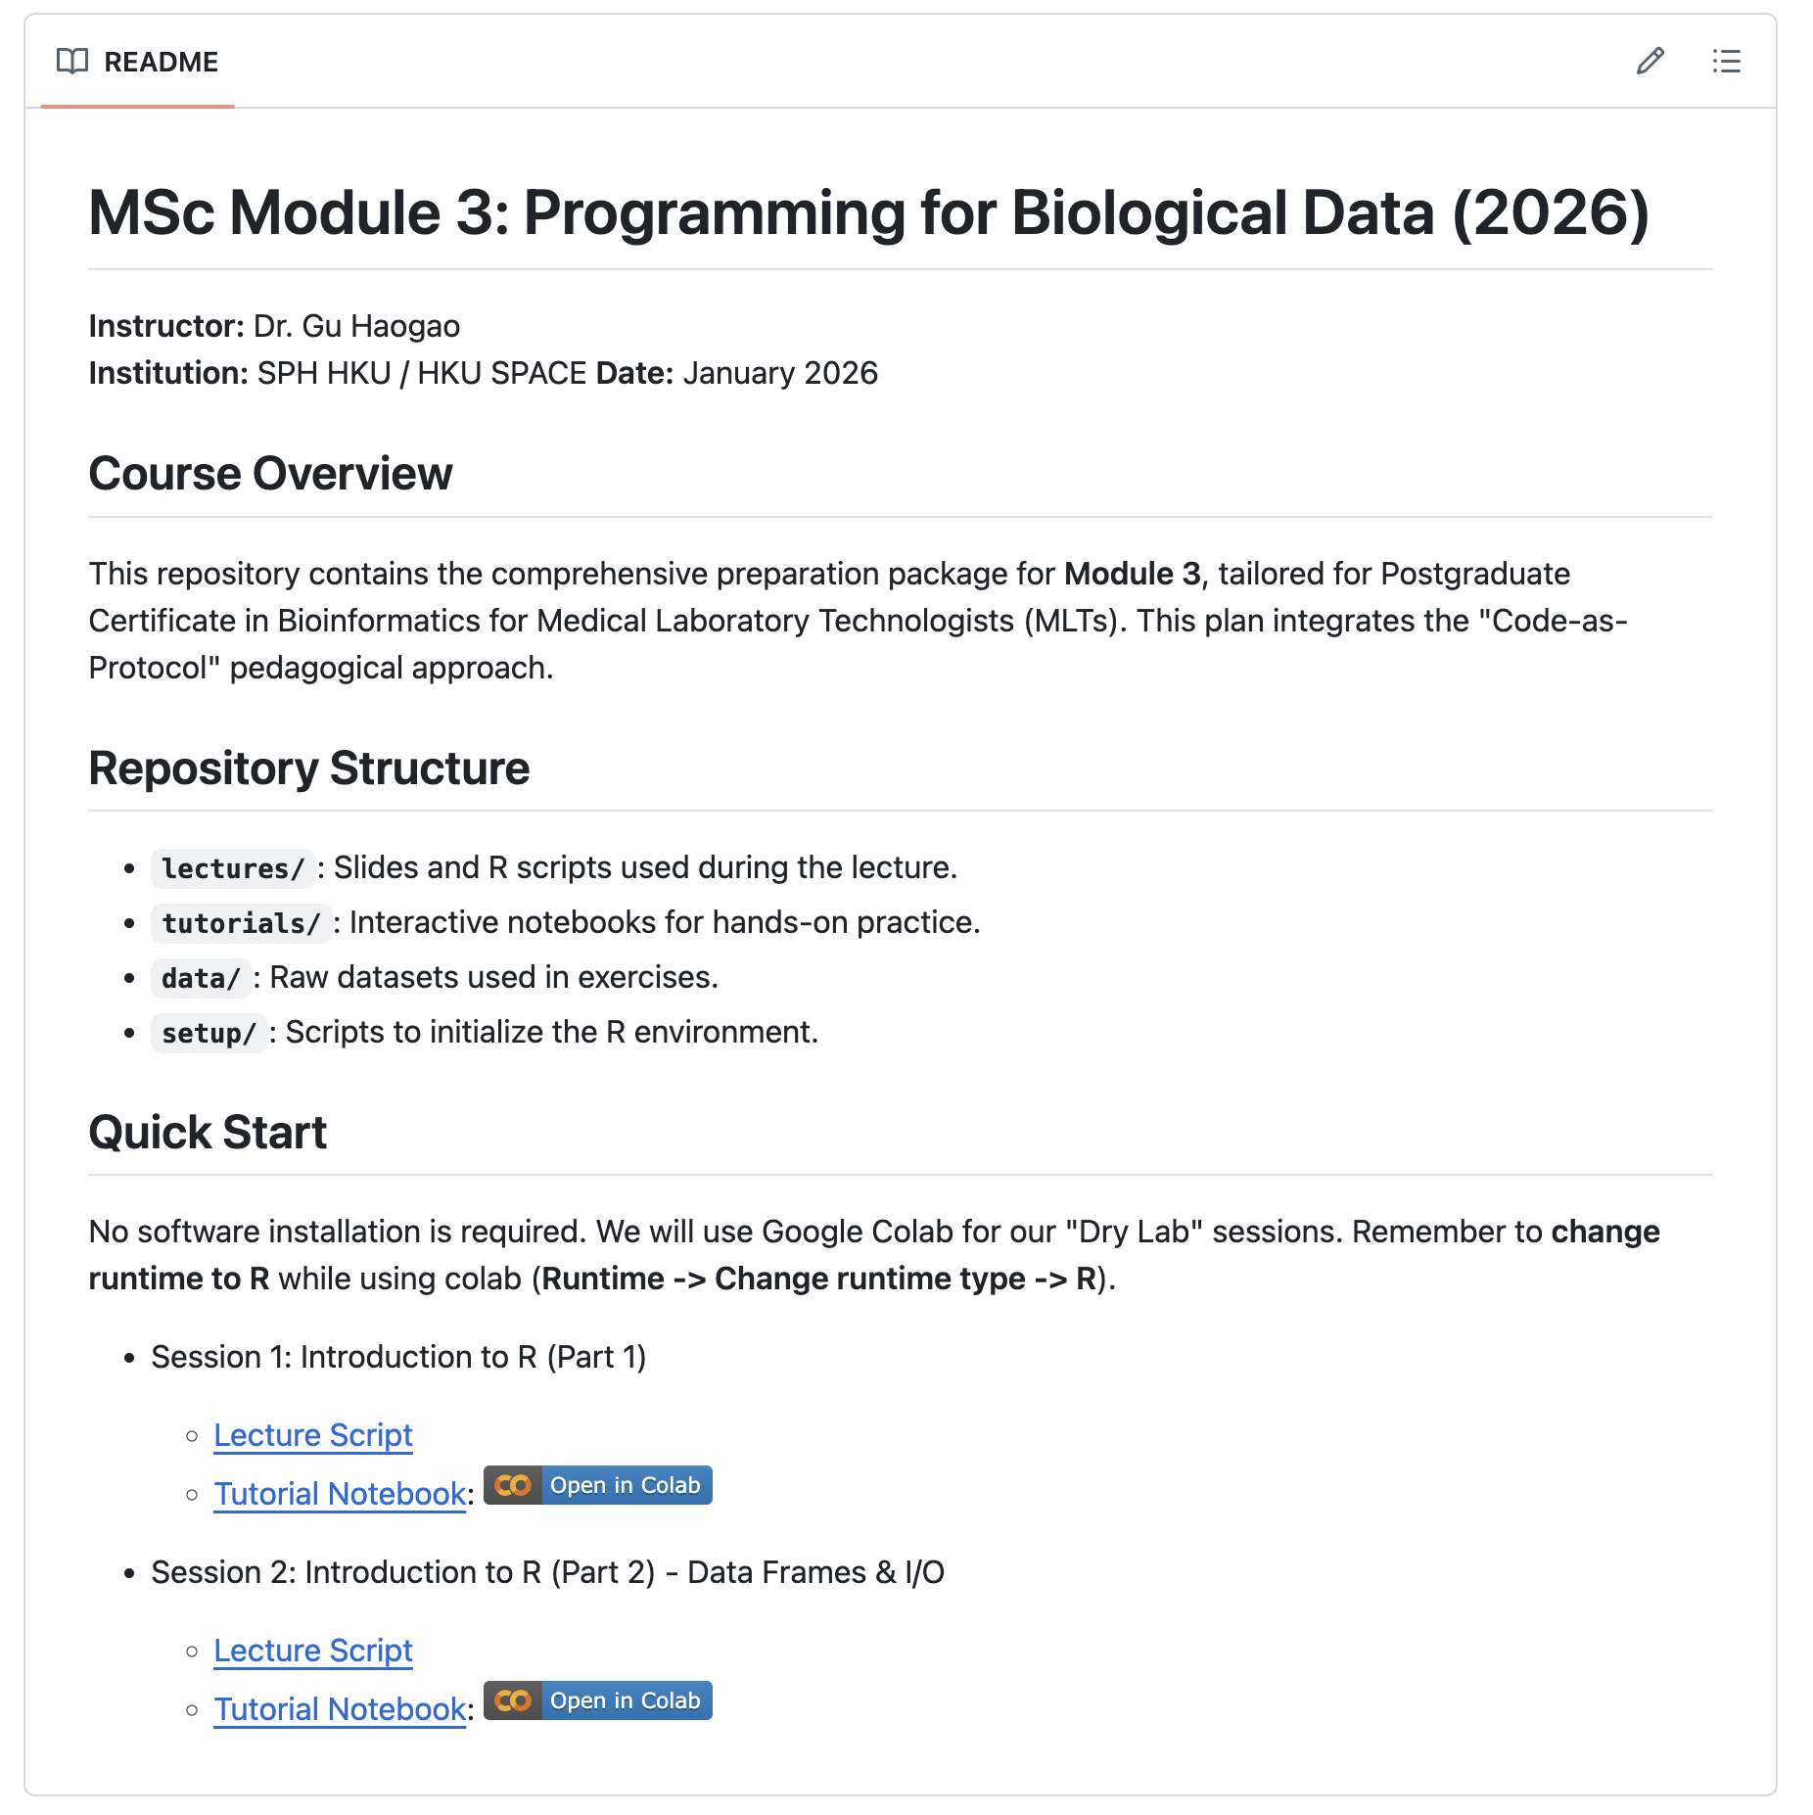

https://github.com/Koohoko/MSc_Module3_Programming_BioData_HKUSpacce_2026

